Slide 1
Banking System
1823-IMTIYAZ KHAN
1828-SHUBHAM MISHRA
1812-EASHAN DESSAI

Slide 2
agenda
Problem statement
Introduction
Sample input and output
Hierarchy chart
Functions
pseudocode

Slide 3
Problem statement
The Banking System is an application for maintaining a person’s account in a bank.
The system provides services related to the maintenance of a customers account and transactions.
The system provides the user with faster , easier and efficient banking services.

Slide 4
Introduction
Bank is the place where customers feel the sense of safety for their property.
to keep the belief and trust of customers, we have ‘The Banking System’.
The banking system is an application which will maintain a person’s account in a bank.
With this system, you can perform banking activities like in a REAL bank
This Banking System will provide the transactions going inside the bank without much manual processing.
Here, you can create a new account, update information of an existing account, view and manage transactions, check the details of an existing account, remove existing account and view customers’ list.

Slide 5
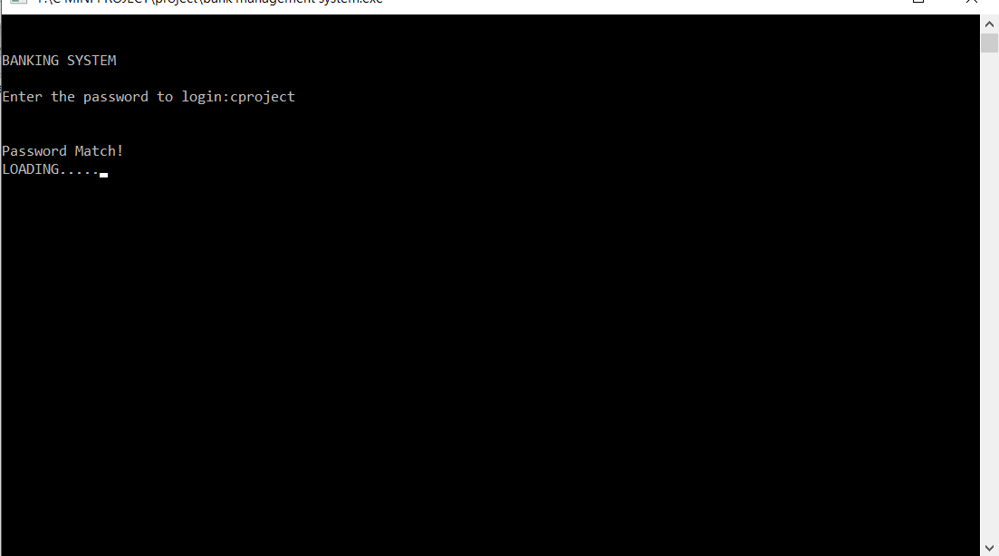
Sample Input and Output Login Page

Slide 6
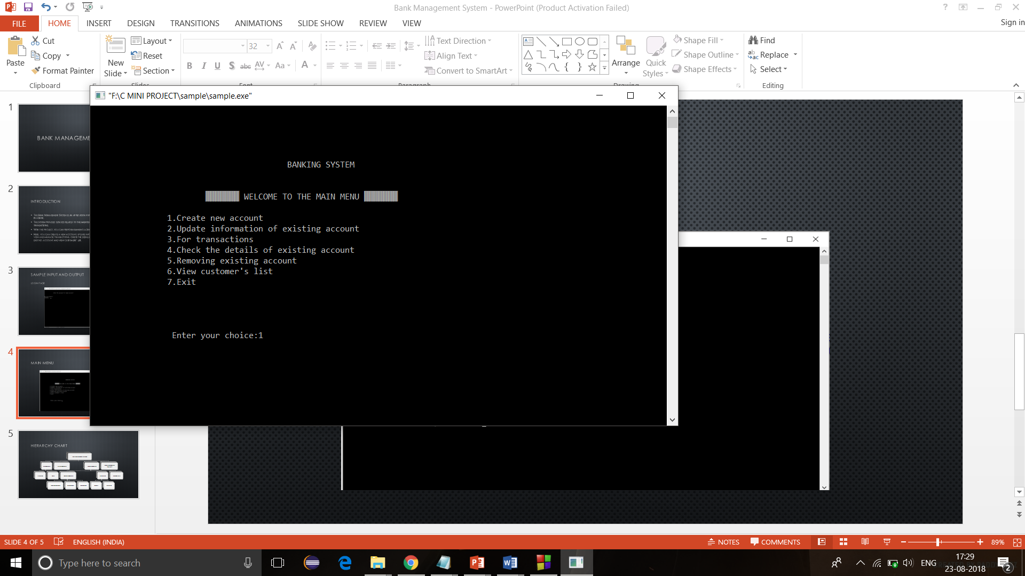
Main menu

Slide 7
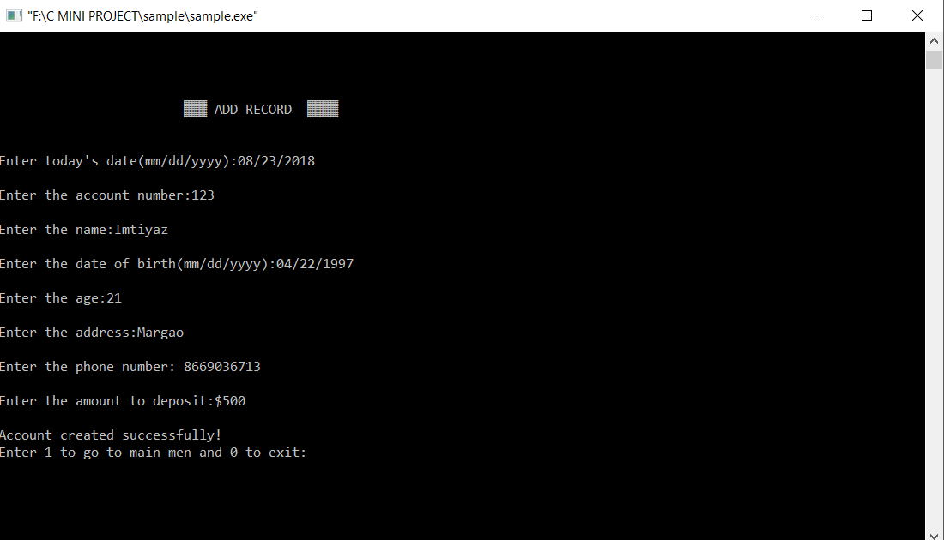
Create new account

Slide 8
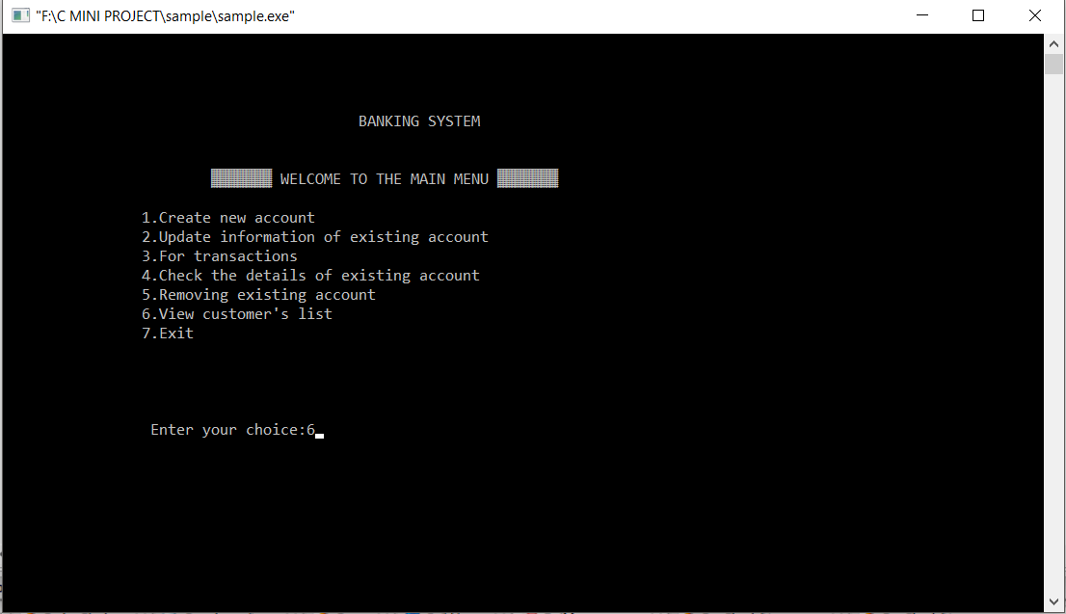
View Customers List

Slide 9
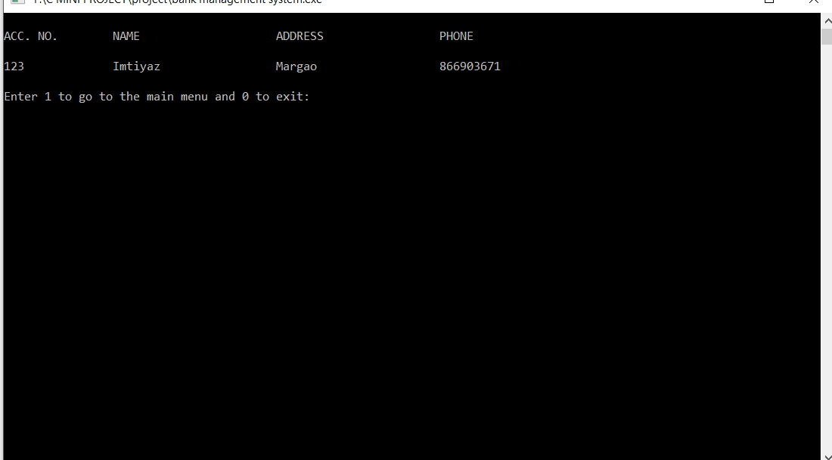
Customers list

Slide 10
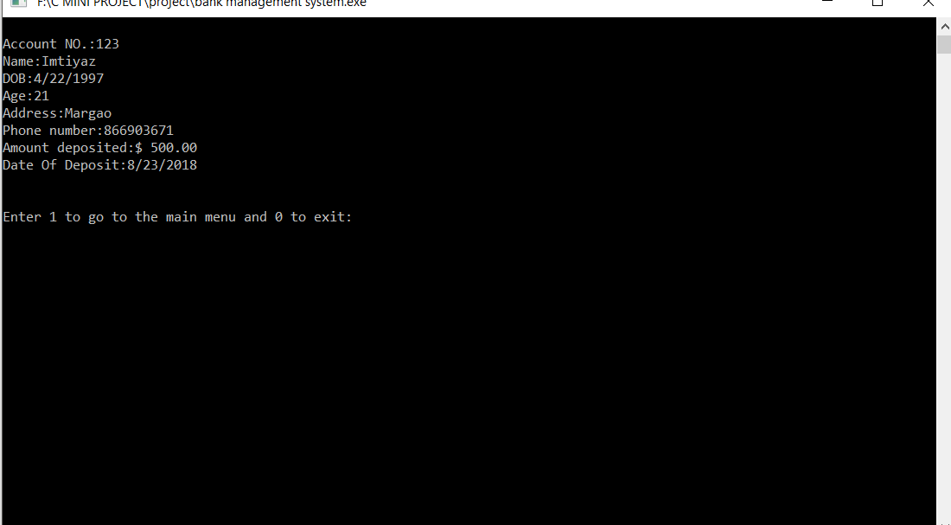
Details of customer

Slide 11
Banking system-Hierarchy chart
Banking System
Start_Module
Print_Intro
Login
Display_Menu
Process_Module
Account_Module
New_acc
Update_acc
Delete_acc
Transaction
Deposit
Withdraw
View_cust_list
Terminate_Module
(Log Out)
Read _Input
Validate_Input
Cust_details

Slide 12
Functions used in the Banking System:
Display_menu() – This function displays the menu to perform different banking activities.
new_acc() – This function creates a new customer account.
Cust_details() – This function shows account number, name, date of birth, age, address, phone number, amount deposited and date of deposit.

Slide 13
Contd..
Update_acc() – This function has been used for changing the address and phone number of a particular customer account
transact() – With this function, you can deposit and withdraw money to and from a particular customer account.
Delete_acc() – This function is for deleting a customer account.
view list() – With this function, you can view the customer’s banking information such as account number, name, address and phone number provided while creating the account.

Slide 14
Data declarations
Variable | Data type
Customers,dob | structure
Cust_name, address | Char array
Phone no. Age, acct_no. ammount | Double int Int float

Slide 15
pseudocode
Main_module()
1.Start
2.Start_module
Display intro
Read password from user
Validate password
if (password == FALSE)
begin if
Display “Incorrect password”
else if(password == TRUE)
Goto main menu
3.Display_menu
Declare variable ‘choice’
Display the entire Main menu
Read input from user
4.Process_module
If (choice==1)
Create new account
If (choice ==2)
Update account

Slide 16
Contd..
4.Process_module
If (choice==3)
Perform transactions
Deposit
Withdraw
If (choice ==4)
Display customer details
If (choice ==5)
Delete account
If (choice ==6)
View customer List
If (choice ==7)
Exit from main menu
5.Terminate Module

Slide 17
Thank you

